Slide 1

Employee Performance Evaluation System
Presented by Bekbolotov Emir

Slide 2






Project Overview
Purpose
Manage employee performance evaluations efficiently
CRUD Operations
Create, Read, Update, Delete evaluations
Report Generation
Summary of total evaluations and average ratings
Data Persistence
Store data securely in file system

Slide 3
Key Features
CRUD Operations
Additional Features
Add new evaluations
Generate summary reports
View all evaluations
Save data to evaluations.txt
Update existing entries
Validate input to prevent errors
Delete outdated records

Slide 4
Project Architecture
Main.java
EvaluationManager.java
Evaluation.java
Application entry point
Handles CRUD and reports
Data model for an evaluation
FileUtils.java
evaluations.txt
Manages file saving/loading
Persistent data storage

Slide 5
How It Works
Main Menu
Add Evaluation
View Evaluations
Generate Report
Access all system functions
Input employee performance data
List all records clearly
Summarize key metrics

Slide 6

Challenges and Solutions
Input Validation
Prevent empty and invalid inputs
Data Persistence
File-based storage for session continuity
Duplicate IDs
Ensure unique employee identifiers
Helper Methods
Modular validation and file handling

Slide 7



Conclusion
Project Achievements
Learning Outcomes
File handling, modular design, error management
Implemented CRUD and report generation
Future Improvements
Graphical User Interface (GUI)
Database integration
User authentication

Slide 8
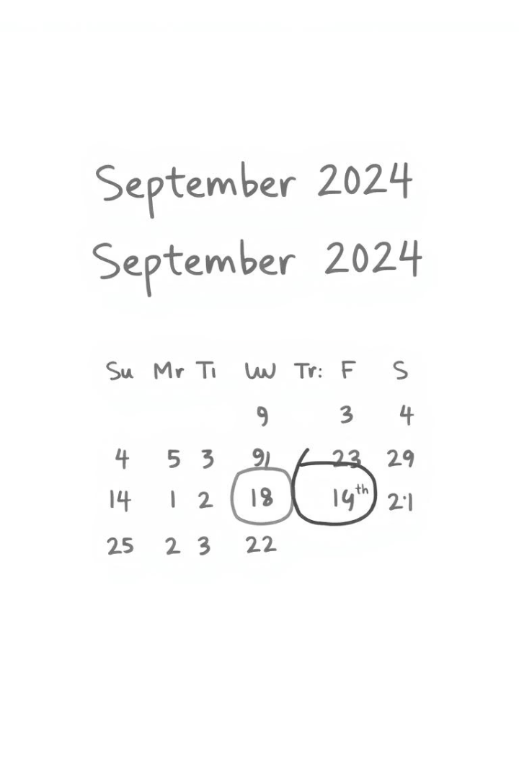




Design Requirements
Consistent Color Scheme
Readable Fonts
Relevant Visuals
Clean Layout
Ensure concise text and visual harmony across slides.

Slide 9



Next Steps
Develop GUI
Enhance user interaction
Integrate Database
Improve data management
Implement Security
User roles and authentication
Gather Feedback
Iterate and improve system

